Slide 1

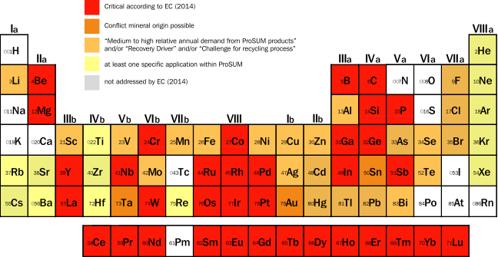

Prospecting Secondary raw materials in the Urban mine and Mining wastes
INTRODUCTION
The ProSUM Project aims to provide an inventory of secondary raw materials, particularly critical raw materials (CRMs), arising in WEEE, ELVs, waste batteries and mining wastes. This inventory will support the EU European Innovation Partnership’s Strategic Implementation Plan to build an EU raw materials knowledge base.
To date, data on primary and secondary raw materials is available but scattered amongst various institutions. The data are often stored in different databases and formats making it difficult to merge, compile and compare data.
The data may also have been produced using different sampling and analytical approaches or provide an incomplete characterisation of materials and elements.
The project will harmonise available data to produce the inventory which will be housed on the EU Urban Mine Knowledge Data Platform and accessed by a user friendly portal.
Knowledge and intelligence is being shared with a wide range of stakeholders and ’end users’ through participation in the ProSUM Information Network.
The EU Urban Mine Knowledge Data Platform
DATA HARMONISATION
Use friendly portal
Single Inventory
Linked with raw materials data
National and EU databases (including Member State data on Directive returns) and published reports will be screened for reliable and interoperable data.
The need for additional standards and datasets including the need for harmonised methods for characterisation of products and wastes will be identified.
Inventory of Critical Raw Materials to improve the knowledge base
ProSUM INFORMATION NETWORK
Be part of the community
Participate in events
Get project results
Keep up to date
Access data and intelligence
Improve the EU knowledge base
THE EU-URBAN MINE KNOWLEDGE DATA PLATFORM
The existing EU Minerals Knowledge Data Platform aims to give simplified, user friendly and efficient access to all available and new data on mineral resource potential in the EU. "The EU-UMKDP will complete the picture with the inclusion of data on secondary
sources of raw materials from the “Urban Mine”. The result will be seamless access to data on resources from extraction to end of life products with the ability to reference all spatial and non-spatial data.
http://minerals4eu.brgm-rec.fr/
Register at: prosumproject.eu
PRODUCT AND WASTE
CHARACTERISATION
STOCKS AND FLOWS
CHARACTERISATION
Available data is being screened and consolidated for products, components, pre-processing wastes and deposits of mining wastes to identify the factors that affect CRM content. This will include CRM trends and scenarios in future products and components.
Existing sampling, sample preparation and chemical analysis methods for a set of "particularly interesting" products, components and wastes will be reveiwed and validated.
Harmonised update and quality assessment protocols for CRM content in products, components and wastes will be developed to allow for the collation and inclusion of future data in the EU-UMKDP.
Existing product volumes in the Urban Mine will be quantified together with how they move through Europe, as reported by the official Producer Responsibility regime, and where they leave Europe, as complementary waste streams.
The reliability of estimates of the flows arising from stocks and the flows of waste collection and treatment will be improved.
This will allow for harmonised protocols to identify future stocks and flows.
FUNDING
ProSUM ELEMENTS
The project is funded by the European Union’s Horizon 2020 research and innovation programme (€3.051m) and the Swiss Government (€0.62m). The project will be delivered over three years, ending in December 2017. Grant agreement No 641999.
The project aims to present data on the elemental composition of the target products and wastes in the urban mine. Detailed procedures are being devised to establish rules for assessing reliable data. Elements within the scope of the project include: those identified as critical raw materials by the EC; those with possible conflict mineral origin; those with a
medium to high use in the scope products; those which drive the recovery value chain; those which pose a challenge for recycling processes; and those with at least one specific application in the ProSUM products.
Methods and tools will be put in place which bring these waste products into the INSPIRE framework for the first time.
PARTNERS
Project Manager
James Horne (WEEE Forum)
James.horne@weee-forum.org
Scientific Coordinators
Jaco Huisman (UNU)
Nikos Arvanitidis (EGS)
www.prosumproject.eu

