Slide 1
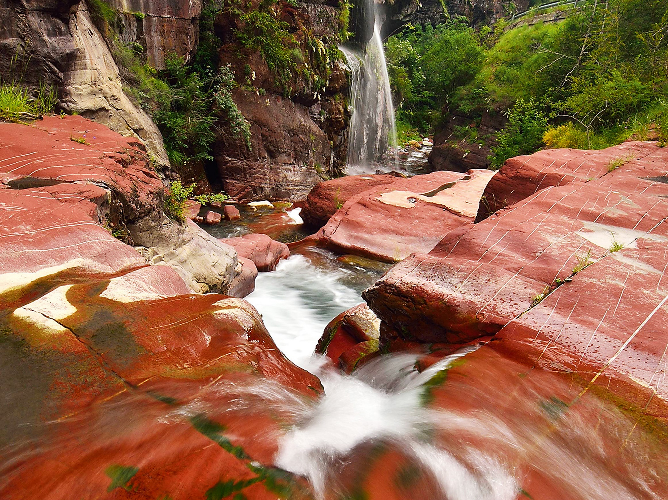
BRGM
THE FRENCH GEOLOGICAL SURVEY

Slide 2
UNDERSTANDING
geological phenomena and associated risks.
THE FRENCH GEOLOGICAL SURVEY
THE BRGM IS FRANCE’S LEADING PUBLIC INSTITUTION WORKING IN EARTH SCIENCE APPLICATIONS FOR THE MANAGEMENT OF SURFACE AND SUBSURFACE RESOURCES AND RISKS.
ITS ACTIVITIES ARE GEARED TO SCIENTIFIC RESEARCH, SUPPORT TO PUBLIC POLICY DEVELOPMENT AND INTERNATIONAL COOPERATION.
DEVELOPING
new methodologies and techniques.
PRODUCING
and disseminating data to support the management of soils, subsoils and their resources.
DELIVERING the necessary tools for managing soils, subsoils and their resources, preventing risks and pollution and developing climate change policies.
Over
1000 staff
including more than 700 engineers and researchers

Slide 3
A PUBLIC INDUSTRIAL AND COMMERCIAL INSTITUTION (EPIC) ESTABLISHED IN 1959
THE BRGM WORKS UNDER THE AUTHORITY OF
THE MINISTRY FOR EDUCATION, HIGHER EDUCATION AND RESEARCH,
THE MINISTRY FOR ECOLOGY, SUSTAINABLE DEVELOPMENT AND ENERGY,
AND THE MINISTRY FOR THE ECONOMY, INDUSTRY AND DIGITAL TECHNOLOGY.
CERTIFICATION AND ACCREDITATION
ISO 9001 QUALITY STANDARD SINCE 2004,
ISO 14001 ENVIRONMENTAL QUALITY STANDARD SINCE 2012.
COFRAC ACCREDITATION FOR ALL BRGM LABORATORIES.
THE BRGM IS ONE OF THE CARNOT INSTITUTES.

Slide 4
14.33 M€ 2013 turnover
20.50 M€ 2013 turnover
BUILDING ON GEOLOGY AS ITS CORE COMPETENCE, BRGM DEVELOPS EXPERT KNOWLEDGE IN RESOURCE MANAGEMENT, RISK MANAGEMENT AND INNOVATIVE ECOTECHNOLOGIES.
THESE ACTIVITIES ARE ORGANISED INTO 10 MAIN TOPIC AREAS THAT ADDRESS DIFFERENT INDUSTRIAL AND SOCIAL CHALLENGES.
GEOLOGY
ENVIRONMENT AND ECOTECHNOLOGIES
7.07 M€ 2013 turnover
17.29 M€ 2013 turnover
MINERAL RESOURCES
RISKS
7.16 M€ 2013 turnover
24.99 M€ 2013 turnover
GEOTHERMAL ENERGY
POST-MINING
4.31 M€ 2013 turnover
5.36 M€ 2013 turnover
GEOLOGICAL STORAGE OF CO₂
LABORATORIES AND EXPERIMENTATION
23.52 M€ 2013 turnover
8.23 M€ 2013 turnover
WATER
INFORMATION SYSTEMS

Slide 5
BRGM Team
Name | Directorate | WP | Role
Guillaume Bertrand | GeoResources | 5
Daniel Cassard | GeoResources | 5 | WP5 Leader
Nicolas Chauvin | Information Technologies | 5
Jean Gonçalves | Information Technologies | 5
Sylvain Grellet | Information Technologies | 5
Pascal Perrier | Information Technologies | 5
Agnès Tellez-Arenas | Information Technologies | 5
François Tertre | Information Technologies | 5 | WP5 Deputy
Gaël Bellenfant | Risk Management & Prevention | 4
Françoise Bodenan | Water, Environment & Ecotechnologies | 4
Anne-Gwenaelle Guézennec | Water, Environment & Ecotechnologies | 4
Maurice Save | Water, Environment & Ecotechnologies | 4
Jacques Villeneuve | Water, Environment & Ecotechnologies | 5 | T5.2.2 Leader

Slide 6
THE FRENCH gEologiCAL SURVEY
Head Office Tour Mirabeau 39-43, quai André-Citroën 75739 Paris Cedex 15 - France Tél.: +33 (0)1 40 58 89 00
Scientific and Technical Centre 3, avenue Claude-Guillemin BP 36009 45060 Orléans Cedex 2 - France Tél.: +33 (0)2 38 64 34 34
Reference Centre Maison de la Géologie 77, rue Claude-Bernard 75005 Paris - France Tél.: +33 (0)1 47 07 91 96

