Slide 1
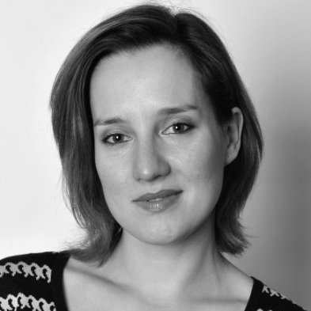
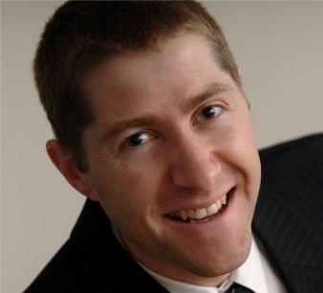
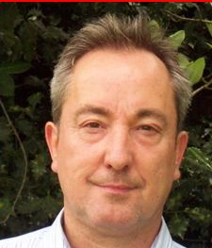
Agata
Wolk-Lewanowicz
Gerrard Fisher
Peter Mitchell
James De Couter

Slide 2
WRAP is an independent, not-for-profit company, recognised in the UK and internationally for its expertise in the circular economy, resource efficiency and product sustainability.
Set up in 2000 to help recycling take off in the UK and to create markets for recycled materials, our role has now broadened into one where WRAP acts as a catalyst to accelerate change in the behaviour of consumers and the public and private sectors across all areas of resource efficiency
Notes:
As understanding grew that 'waste' is actually 'stuff with value' and that wasting resources made no environmental or commercial sense, governments across the UK increased efforts to tackle these issues.
We are now a charity which will give us even more independence and flexiblity in terms of focusing on social as well as environmental and economic benefits.

Slide 3
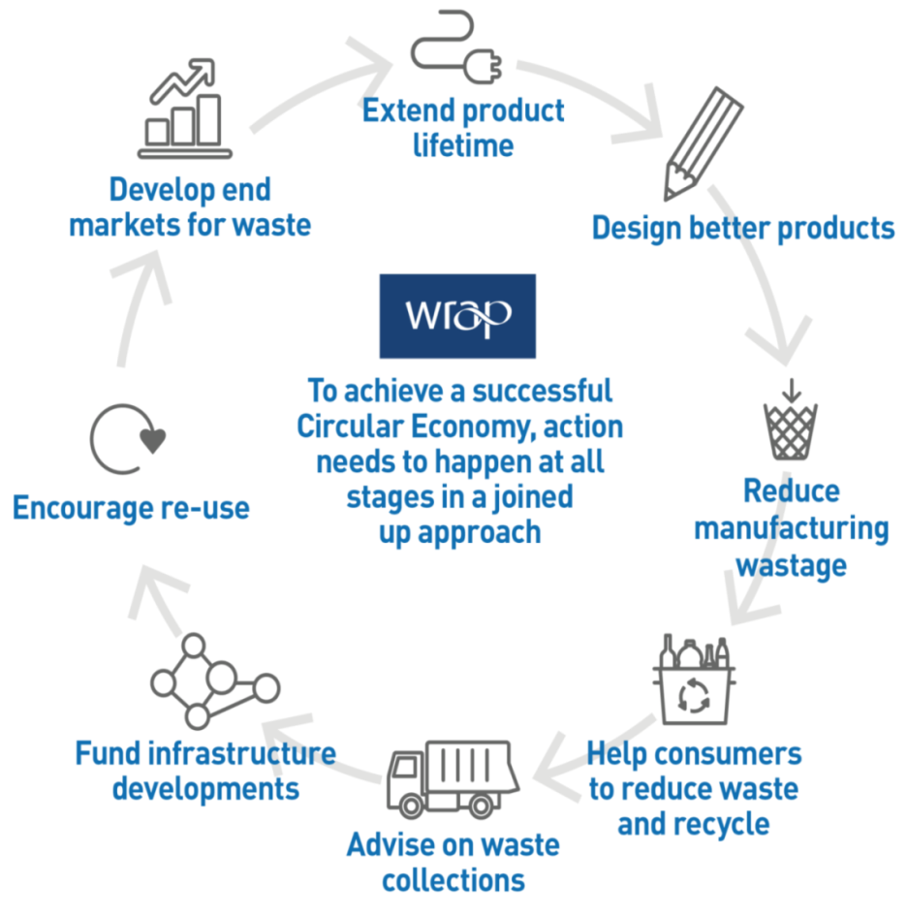
Our vision
WRAP’s vision is a world where
resources are used sustainably
Our role is to:
Provide the evidence
Build the case for change
Act as the broker between government and industry
Deliver practical action on the ground

Slide 4
How we work
Product sustainability – reinventing how we design, produce and sell products
Behaviour change – rethinking how we buy, use and consume
Improving collections and processing systems – redefining how we re-use and recycle
Notes:
Product Sustainability – Supply chain collaboration and product and process innovation
Behaviour Change – Consumer campaigns and encouraging business collaborative change
Improving Collections and processing systems – market and infrastructure development, improved collection systems
Examples
Brokered highly successful voluntary agreements with industry, including the Courtauld Commitment, Halving Waste to Landfill and the Sustainable Clothing Action Plan
Consumer Behaviour change campaings – Love Food Hate Waste, Recycle Now and more recently Love Your Clothes

Slide 5
Name | Job Title | WP & Tasks | Past Activities | Future Contribution
Agata Wolk-Lewanowicz | Project Manager/ Key Account Manager | WP1. WP3. Task 3.2.1 and 3.2.2, WP6 | PRINCE 2 Foundation level certification and project management experience from Nielsen and NIRAS. | Task Manager, Collecting data, Comparison of UK and UNU models, Communication and dissemination
Gerrard Fisher | Technical Specialist | WP3 Task 3.2.1 and 3.2.2, WP6 | He has specific expertise in Electrical & electronic product design, specification, re-use and recycling as well as in implementing new business models. | Project design, Communication and dissemination
Peter Mitchell | Economist | WP3. Tasks 3.2.1 and 3.2.2 | 20 years of experience producing economic, policy analysis and research reports on a broad range of economic issues. | Project Design, Predicting future trends, Data Structuring, Design of working template for data collection.
James de Couter | Project Accountant | WP1 | Extensive experience in financial reporting, including recent EU projects. | Project Planning/Financial Reporting

