Slide 1
The ProSUM Project
“I am useful”
Prospecting Secondary raw materials in the Urban mine and Mining wastes
Date
Event
Speaker
Organisation logo

Slide 2
Introduction and objectives
1

Slide 3
ProSUM Objectives
Objective 1 ‘Coordinate’ | Coordinate with a wide range of organisations involved to improve the knowledge base on CRMs in secondary sources
Objective 2 ‘Collect’ | Collect, describe and compile currently available data and trends for CRMs
Objective 3 ‘Collate’ | Collate and harmonise existing data and develop a sampling strategy to model historic and future stocks of CRMs
Objective 4 ‘Construct’ | Construct the EU-UMKDP as the Inventory and Portal providing state-of-the-art data for the four waste groups
Objective 5 ‘Communicate’ | Communicate and disseminate results and recommendations via the Information Network (IN) to support full access to CRM information

Slide 4



An EU Secondary Raw Materials Inventory
Horizon 2020 project Jan 2015 – Dec 2017
Establishment of an Information Network
To create an inventory of CRMs to improve the knowledge base:
  WEEE
  Batteries
  ELVs
  Mining wastes

Slide 5
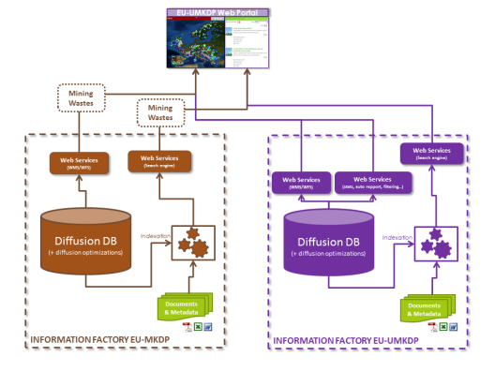


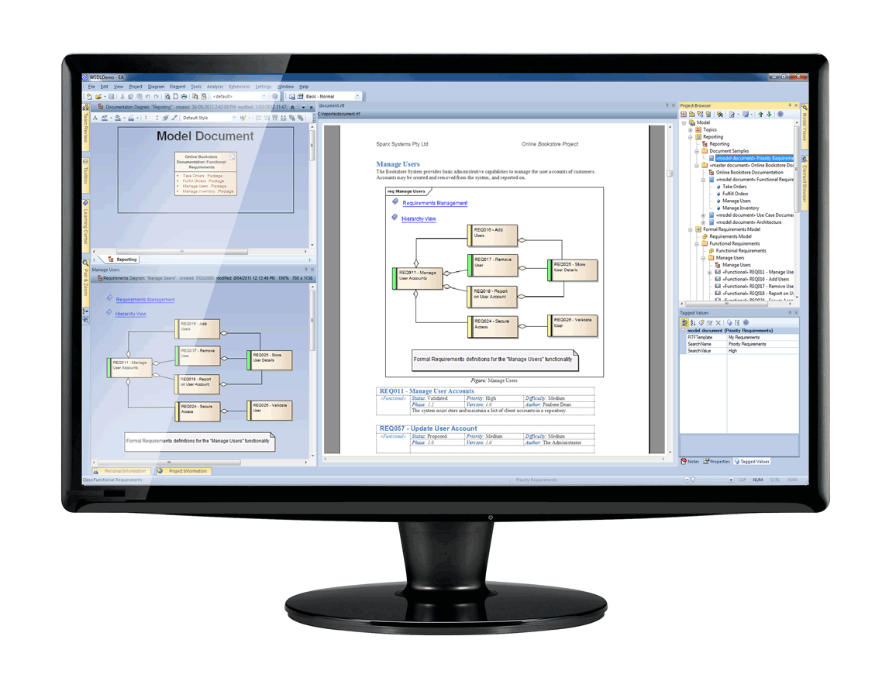


The EU Urban Mine Knowledge Data Platform
User friendly portal
Single inventory
Linked with raw material minerals data
Contributes to EU Knowledge Base
Web-based portal
Data filtering capability
Advanced search capabilities
Statistics computation
Automated report generation & visualisation
Interoperability with the EU-MKDP

Slide 6
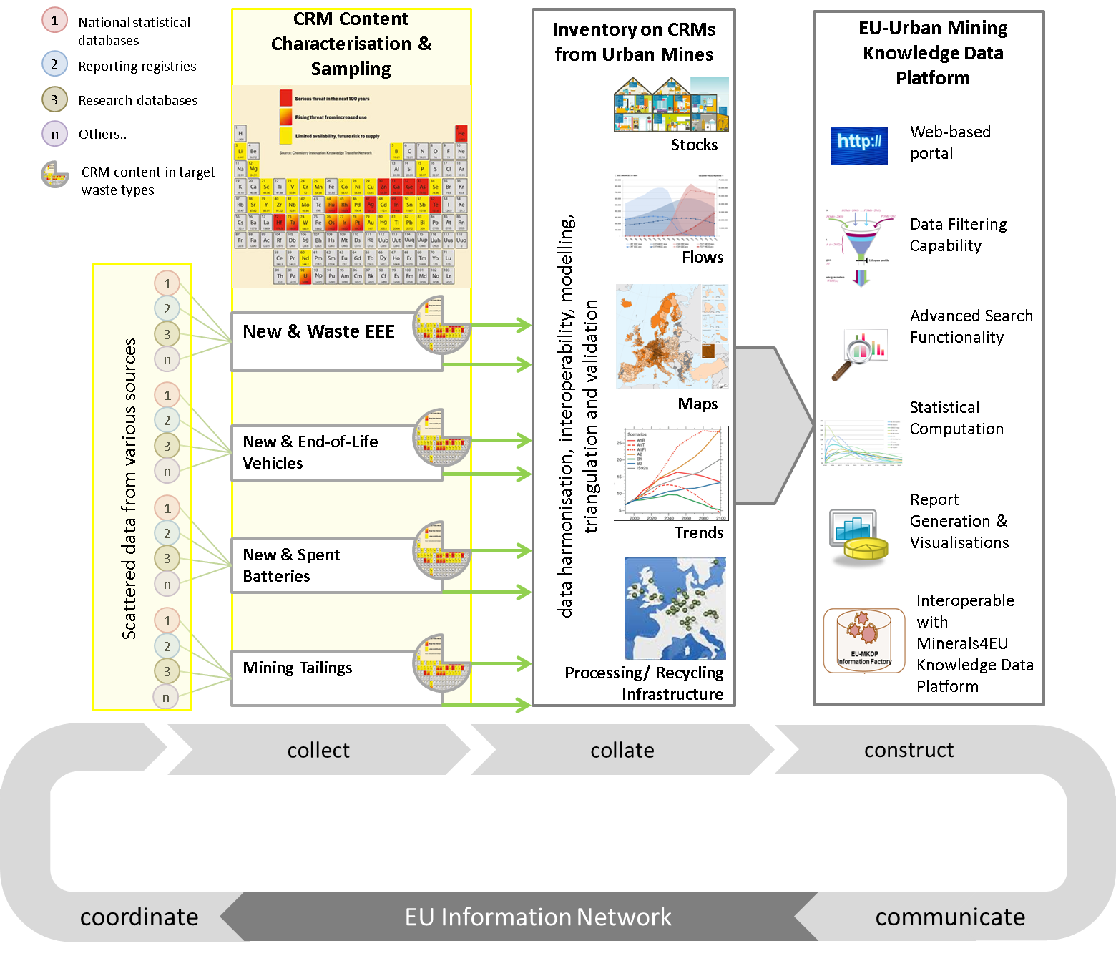

Slide 7
Expected Impact
Better informed decision making EU, MS and by Industry
Increased materials knowledge and transparency
Boosting the raw material sector by allowing the matching of supply and demand
Improving availability of raw materials
Contribute to the EIP

Slide 8


















Slide 9
Background
2

Slide 10
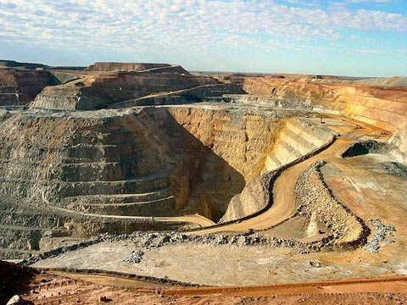
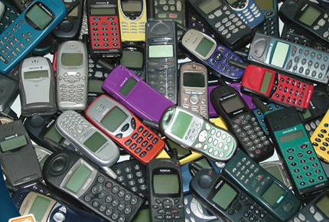
Primary Versus Secondary Stocks
Primary deposits
Secondary deposits
≈ 9 g Au / t*
≈ 280 g Au / t mobile phone (x30)
≈ 1’400 g Au / t PWB (x150)
* highest mass fractions in Kloof gold mine in South Africa
Source: Empa; Umicore

Slide 11
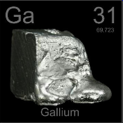
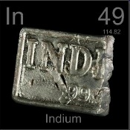
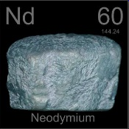
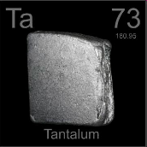
Future Demand Scenarios
Global Demand
2006
Global Demand
2030
in brackets: ratio between demand and world annual production 2006
x 22
28 t
603 t
Thin film photovoltaics, high performance
microchips, WLED
(0.18)
(3.97)
Gallium
x 8
234 t
1911 t
Displays, thin film photovoltaics
(0.40)
(3.29)
Indium
x 7
4’000 t
27’800 t
Permanent magnets, laser technology
(0.23)
(1.66)
Neodymium
x 3
551 t
1410 t
Microelectronic capacitors,
medical technology
(0.40)
(1.02)
Tantalum
Angerer et al. (2009); Eisler et al. (2010)

Slide 12
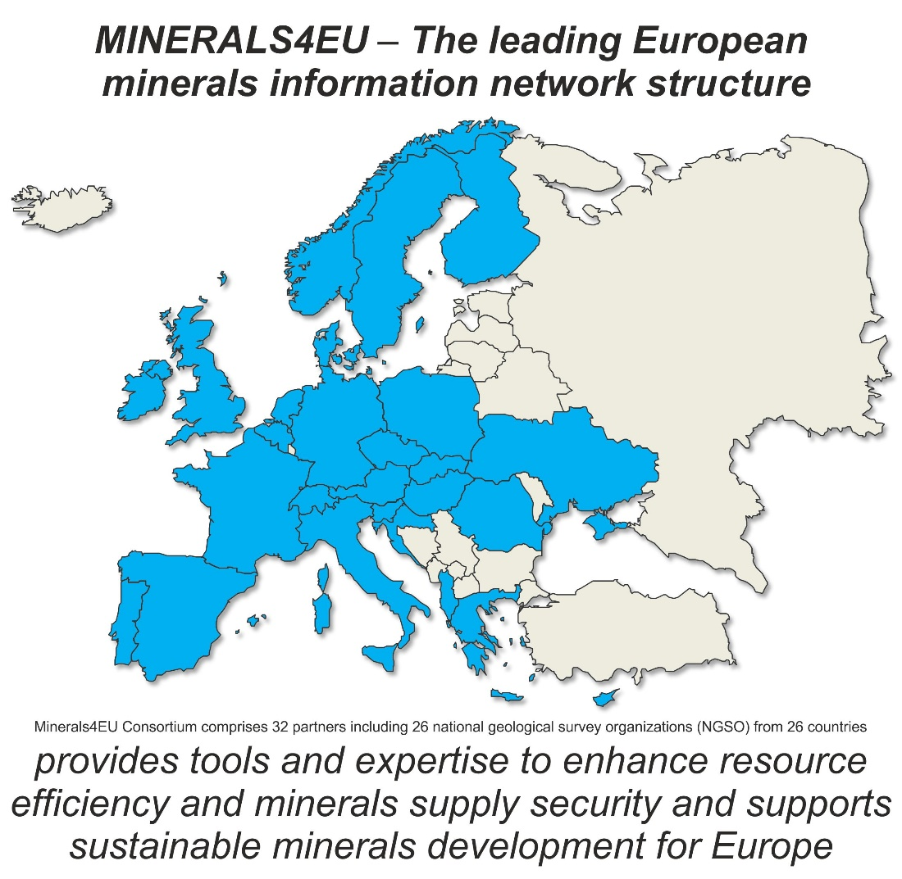
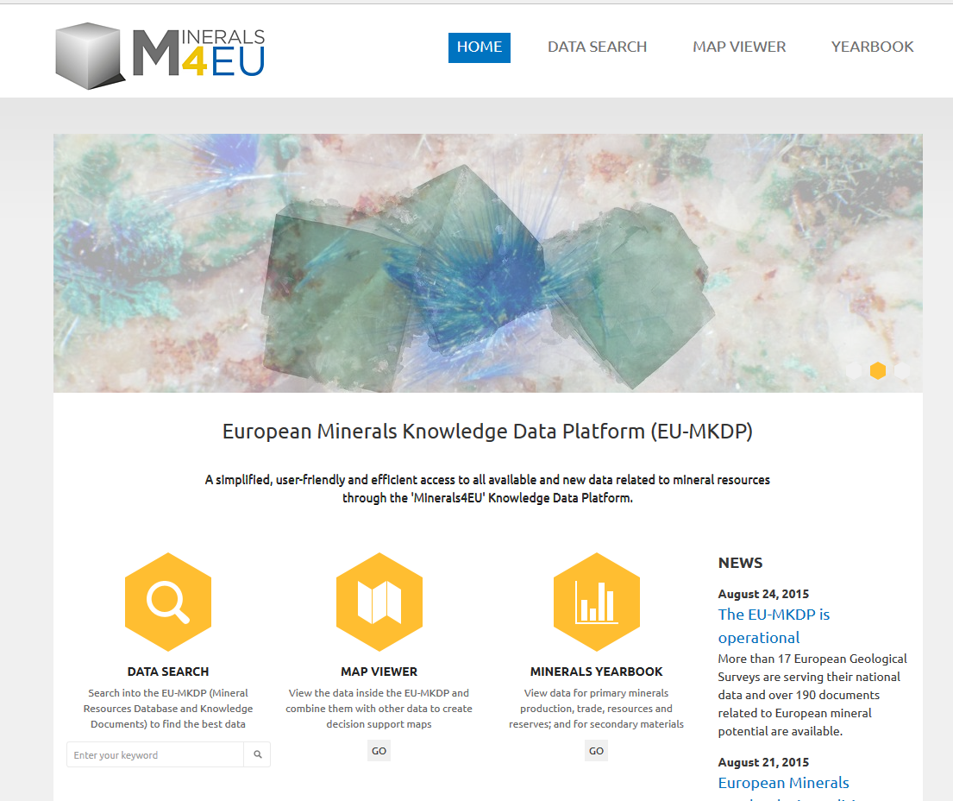
Link to Raw Materials Intelligence
European Minerals Knowledge Data Platform (EU-MKDP)

Slide 13
Elements Relevant for ProSUM Products

Slide 14
Availability in the Urban Mine
Analysis of products, components, materials, substances and elements
text
product
Re-use, refurbishment, remanufacturing
components
materials
substances
elements
sentences
words
syllables
letters
Polymer regranulation, alloyed steel remelting
Recovery of Sb₂O₃, NH₃
Gold recovery
+ element speciation
+ impurities

Slide 15
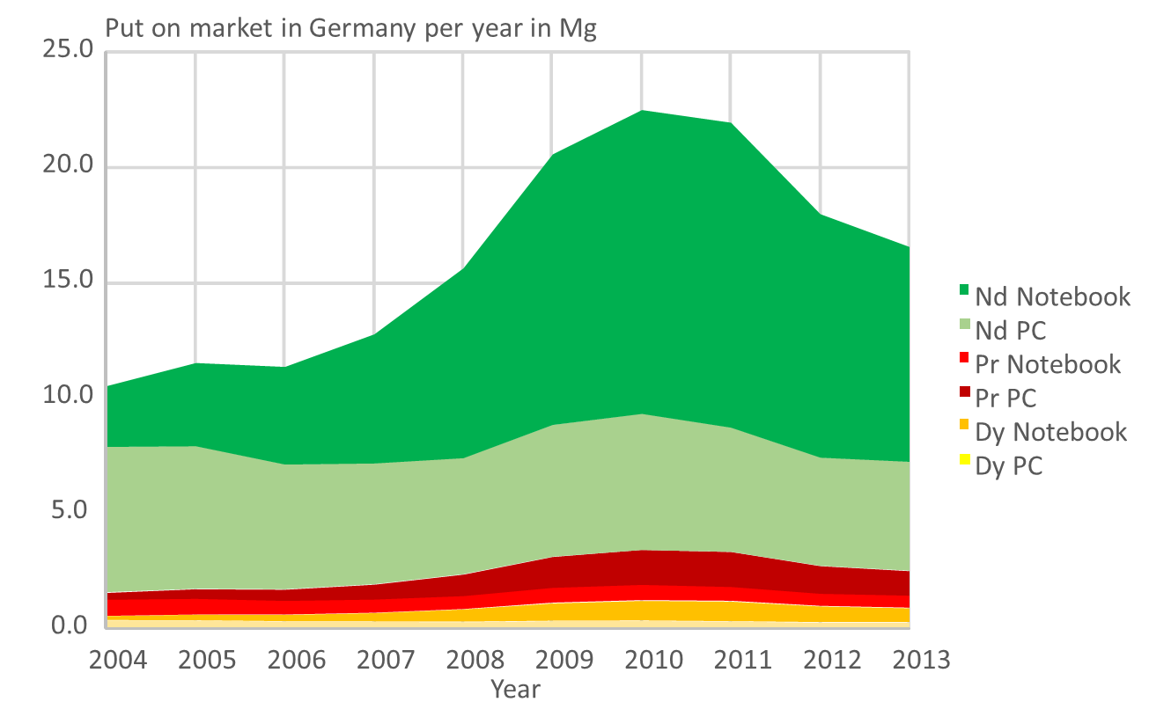
The Need for Information About the Urban Mine
Questions about secondary raw materials relevant for recycling innovation, investment and policy making
When?
Where?
What?
How much?
Ueberschaar Max, Rotter, S Enabling the recycling of rare earth elements through product design and trend analyses of hard disk drives Journal of Material Cycles and Waste Management 17 (2), 266-281

Slide 16
Mining Geological Reserves and the Urban Mine
 | Geologic Mines | Urban Mines
Stocks | Static - no addition to stock | Variation over time and location due to human activities
Composition | Chemical properties influenced by geological cycles | Material properties influenced by product design
Exploration | Traditional, established exploration technologies | Limited
Data management | Established information services through the Geological Surveys | Limited to Eurostat
Characterisation of ores | Standardised analytical methods | Lack of standardised methods for wastes

Slide 17
Year 1 Deliverables and Challenges
3
Screening available data and creating the right architecture

Slide 18
Deliverables – Year 1
Data Screening
Identification of CRM parameters in products
Assessment of current stocks of products
Inventory of waste flows
Assessment of end user data needs
Harmonised system for the classification of data

Slide 19
Challenge 2:
Data Harmonisation
Challenge 3:
Interoperability and updating
Challenge 1:
Data Gaps
Challenge 4:
Knowledge sharing

Slide 20

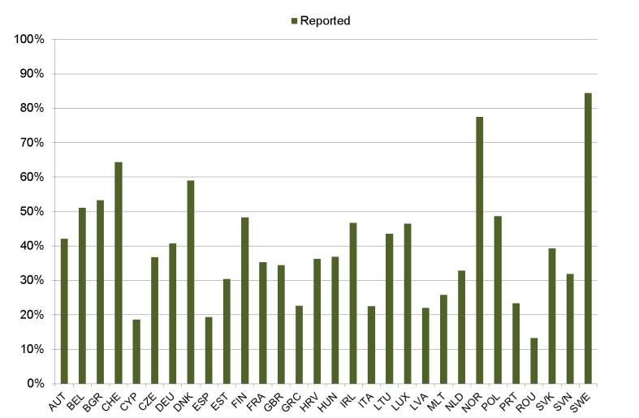
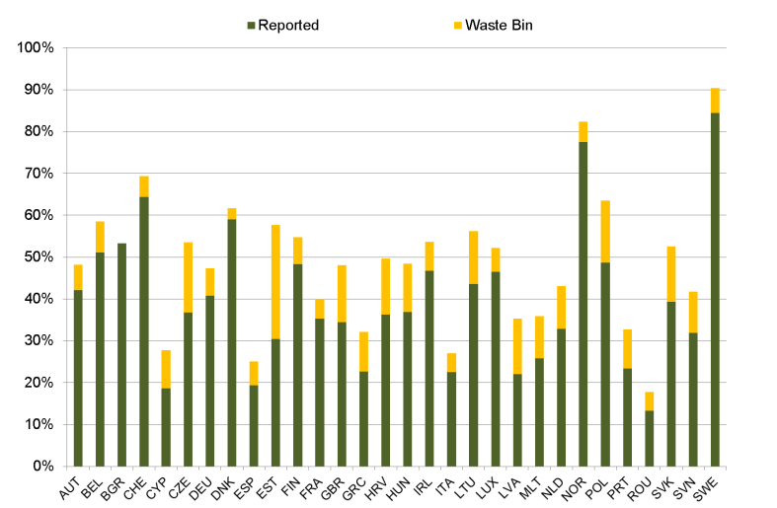
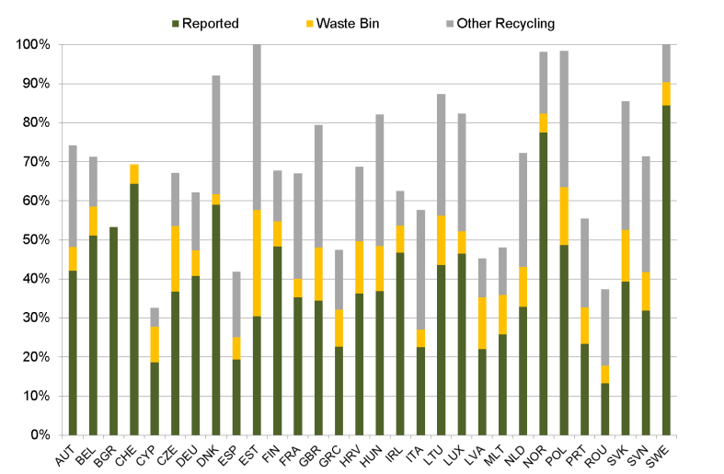
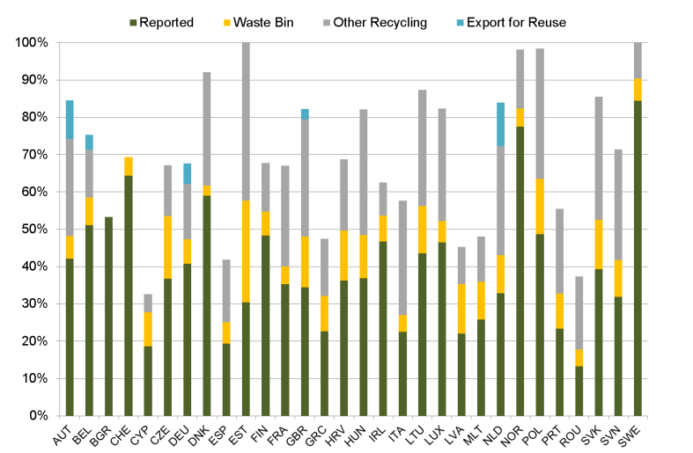
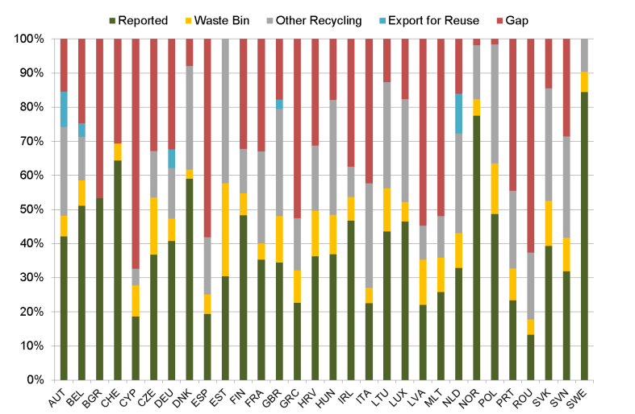
EU WEEE Flows 2012
85%
Challenge 1a:
Linking Product Flow data with Product Composition Data
Notes:
Data also per collection category
Some negative gaps: there is misreporting even for ‘official amounts’.
Remarks per country/ collection category:
Waste bin is consumer behaviour mainly.
Grey is conservative estimate, excl. scavenging of components, professional appliances
Data per collectoin category is also possible.

Slide 21
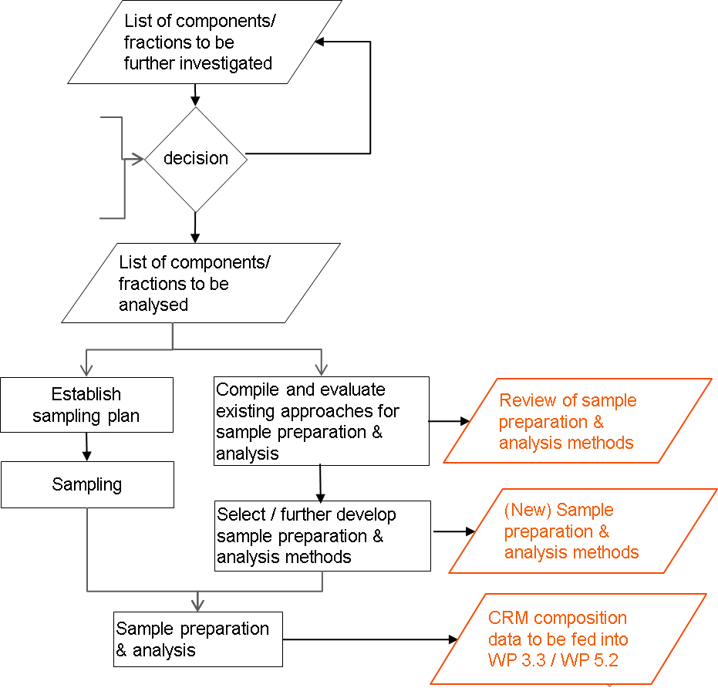
Data Gaps in Product Composition
Challenge 1b:
Sampling data AND
sampling CRM content

Slide 22
Data Harvesting Requires Available Data
>70 data sets Cu, Pb, Ni, Ag, Au, Sb, Cr, Pb
Challenge 1b:
Data gaps in compositional data
< 5 data sets
V, Ce, Co, Mo, Ta, La, Sr, Pt, Hf, Th, Sc, Eu, Zr, Cs
50-20 data sets
Zn, Fe, Sn, Cd, Al, Be
Bibliometric evaluation of published information on metal content in Printed circuit boards (unspecified)
43 references, >1000 data sets

Slide 23
Challenge 2a:
One common
data structure
UNU key
UNU sub key
Products
Section
Components
Section
Device type
Materials Section
Stocks and Flows Section
Consolidated product properties
Material group types
Placed on Market
Component/
systems
Material type
Stocks
Component with specific datasets e.g. PCBs
Batteries
Waste Generation
Material list
Waste Flows
User defined/ commodity list/ INSPIRE list
Element list (periodic table)
Material list
(including observed properties)
User-Defined
Output Lists

Slide 24
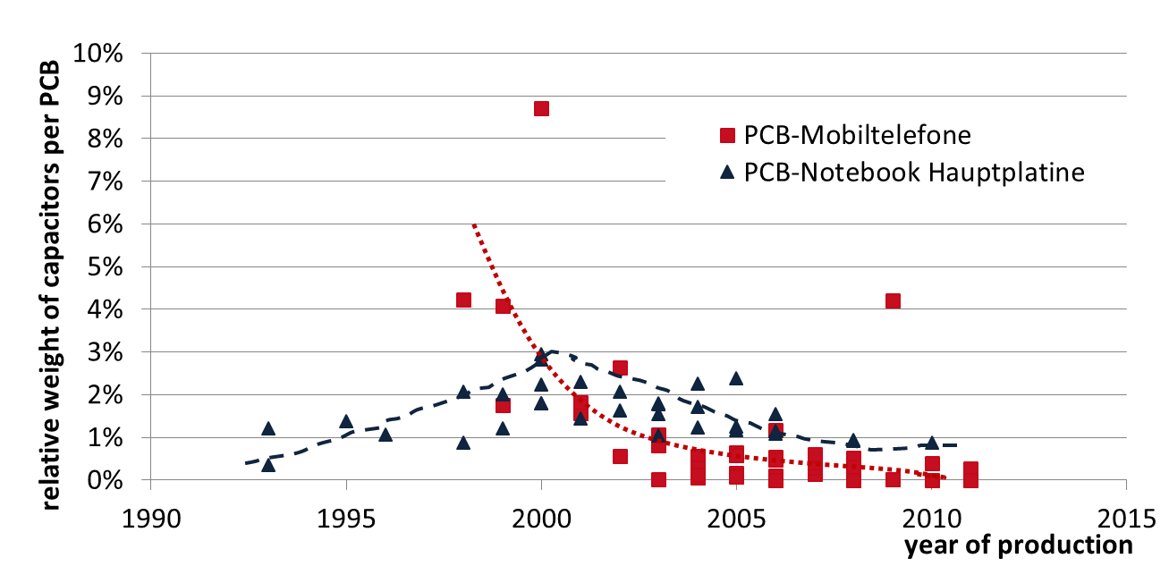
Trends in Material Content
Example:
Tantalum capacitors in Printed Circuit Boards
Challenge 2a:
Data validation –
How to deal with dynamic changes?
TU Berlin Data from the Upgrade Project unpublished

Slide 25

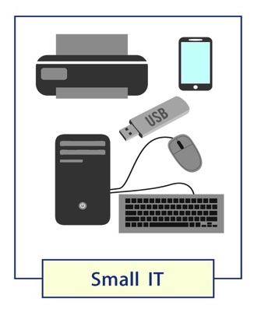
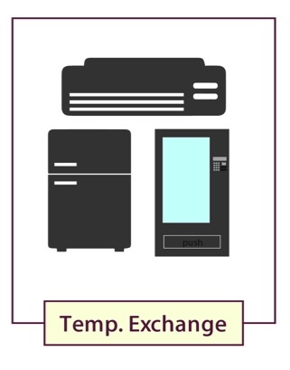


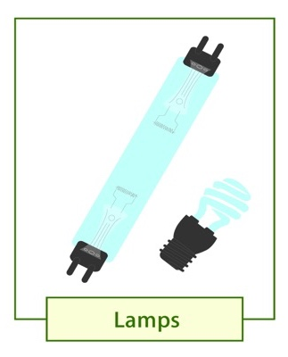

Types of Electronics
Challenge 2b: Uniform Product Classification
> 650 product type
6 waste streams

Slide 26
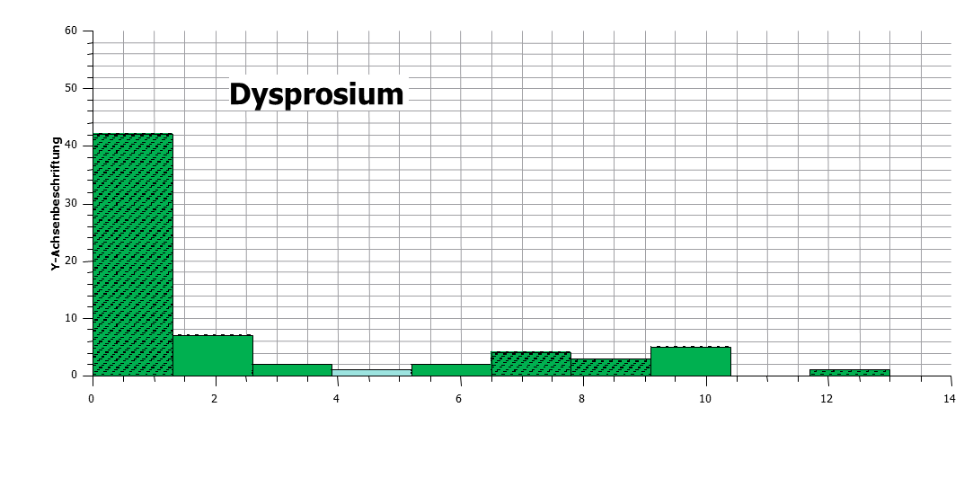
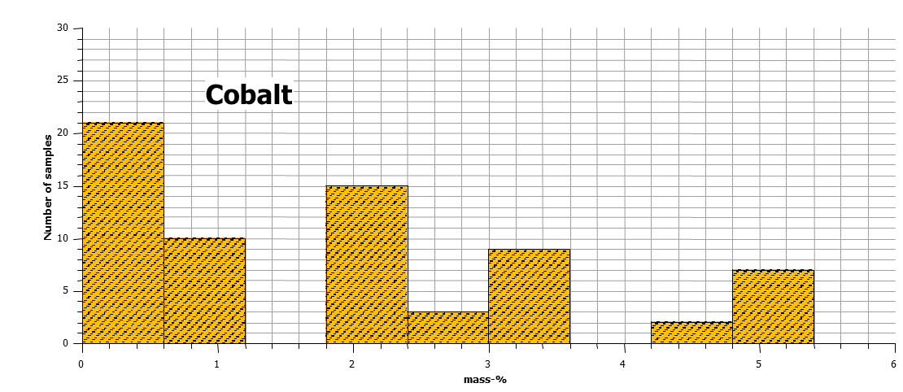
Uncertainties
Example:
Probability distribution for metal mass fraction in 53 permanent magnets
Challenge 2b:
Data validation –
What is the “average in a changing world”?
Ueberschaar Max, Rotter, S Enabling the recycling of rare earth elements through product design and trend analyses of hard disk drives Journal of Material Cycles and Waste Management 17 (2), 266-281

Slide 27
EU Urban Mine Knowledge Data Platform Legacy
Challenge 3:
Interoperability and updating
User friendly portal
Single inventory
Linked with raw material minerals data
Contributes to EU Knowledge Base
Web-based portal
Data filtering capability
Advanced search capabilities
Statistics computation
Automated report generation & visualisation
Interoperability with the EU-MKDP

Slide 28
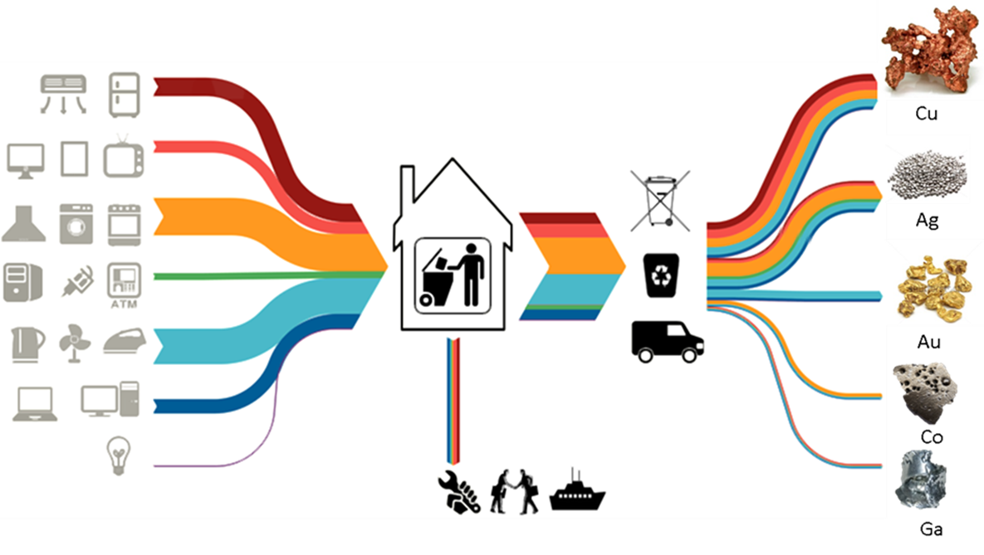
Improving and Exploiting the Knowledge Base
Challenge 4a:
Communicate

Slide 29

The Information Network
Challenge 4b:
Coordination
End user requirements
Improve the knowledge base
Enable coordination
Raise awareness
Facilitate standardisation
Support policy dialogue
Support further research
JOIN THE INFORMATION NETWORK AT:
http://www.prosumproject.eu/

Slide 30
Thank you
For more information:
Email:
Organisation

